Slide 1
Smart Louisville: Transportation in the 21st Century
Ed Blayney

Slide 2
Agenda
Mobility Innovation Team
Breaking down silos
AV Playbook
Why now? What is the purpose?
Next Steps
What we are doing now & next year

Slide 3
Mobility Innovation Team

Slide 4
Timeline
April 2017
Princeton Researcher presents to Leadership
Momentum stalls
October 2017
Bloomberg Map (avsincities.Bloomberg.org)
December 2017
Mobility Innovation Team

Slide 5
Timeline
March 2018
Presentation 2.0 to Leadership
May 2018
Community engagement
July 2018
Release the plan

Slide 6
Composition
Traffic
Air Quality
Transportation Planning
Engineering
Transit
Innovation
Parking
Intelligent Transportation Systems
Multimodal
Land Use

Slide 7
Purpose of the Team
3 Revolutions
Shared, Electric, and Autonomous
Collaboration around new innovations
CAV , Electric Scooters, Ridesharing
Promote ITS and data-driven decisions
Data is the future

Slide 8
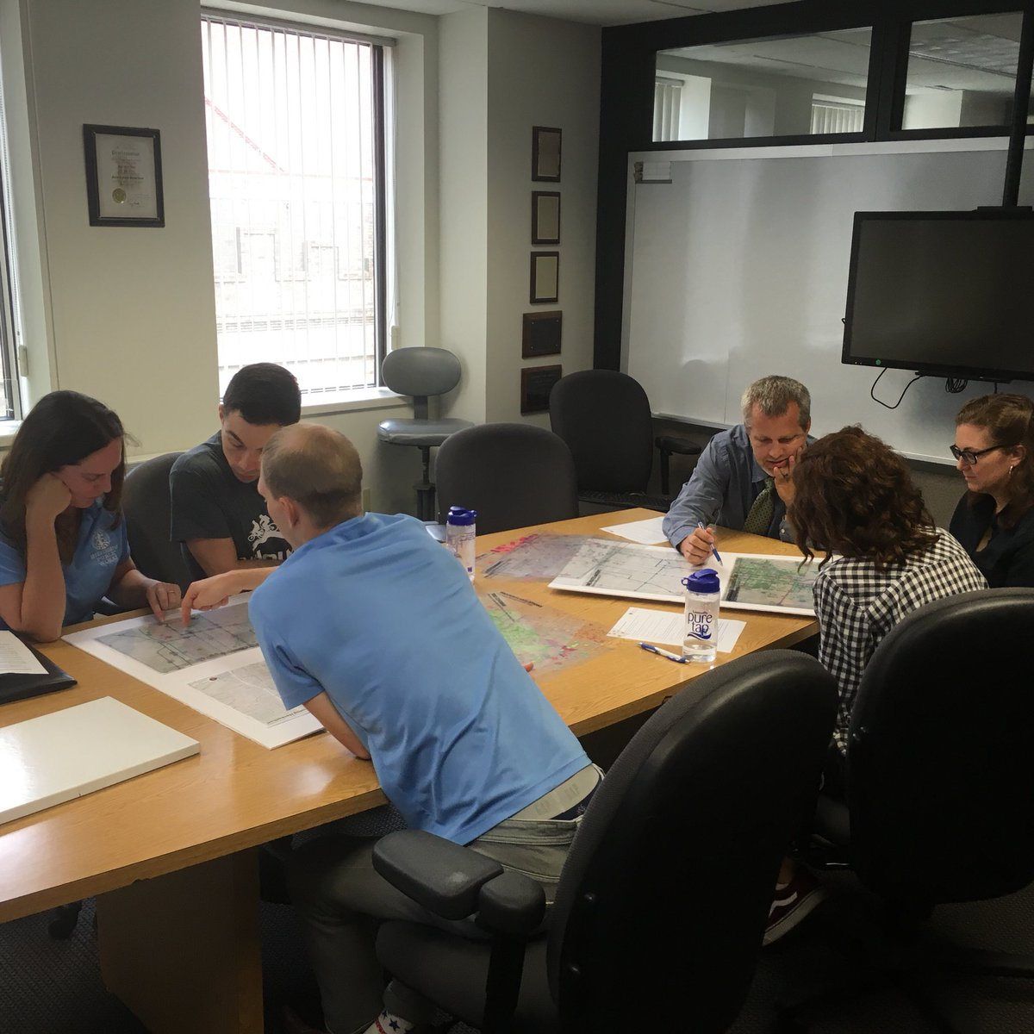

Slide 9
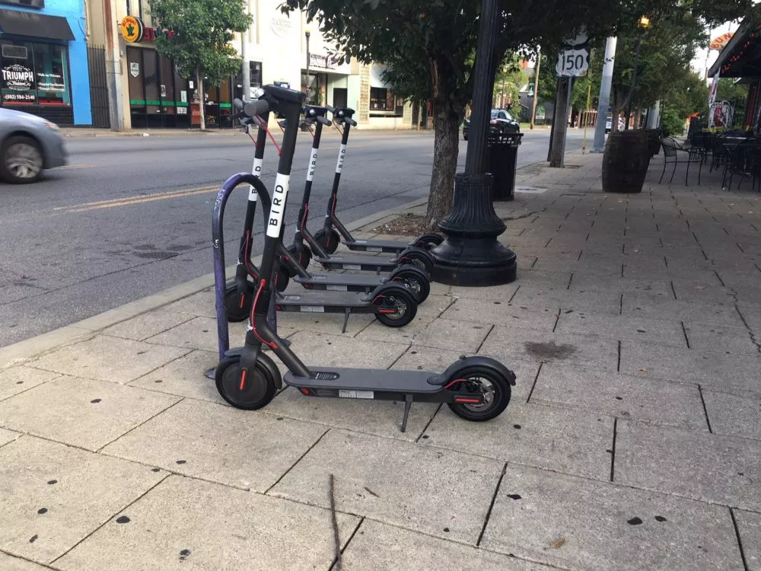

Slide 10
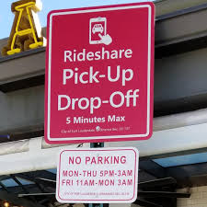

Slide 11
AV Playbook
AV.louisvilleky.gov

Slide 12
Autonomous Vehicle Playbook

Slide 13
Had to get…
Internal Buy-in
Answer the why now question
Expert help
Blind-spots and opportunities
Community Feedback
Education and relationships

Slide 14
Summary
Introduction
Summary of the issues and the impetus for the playbook
Values
The CHASE Principles from Comp Plan
Plays
Strategies to prepare Louisville for AV rollout

Slide 15
National & Industry Landscape

Slide 16
Planning for AVs
Start Now:
Creating Plans & Resolutions
Plan For:
Wide-scale adoption

Slide 17
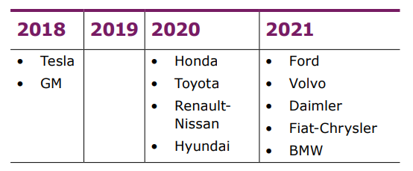
Planned AV rollouts by Automakers

Slide 18
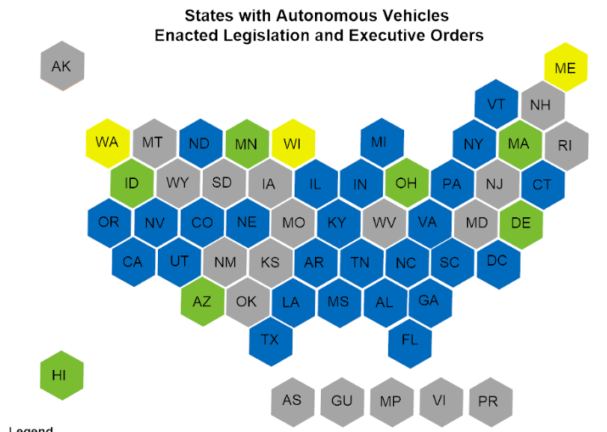
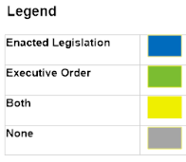

Slide 19
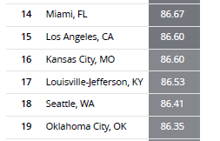
INRIX– Top Cities for AV Deploy
Louisville: 17th
Automakers have internal rankings like this and Louisville is going to be considered a desirable city for deployment

Slide 20
Why now?
Momentum in the industry
Infrastructure needs a long-term view
Build internal knowledge
Opportunity: 17th ranked city

Slide 21
Values

Slide 22
The CHASE Principles
Connected
Healthy
Authentic
Sustainable
Equitable
Rooted in extensive community engagement
Vision Louisville
Over 80,000 ideas were collected in less than two months
The foundational guideposts for the 2040 Comprehensive Plan

Slide 23
Plays

Slide 24
AV Playbook - Plays
Infrastructure/Strategy
Incorporate AVs into our strategic outlook
Partnerships
Be included in key conversations & partnerships
Parking
Prepare for future with less parking demand
Transit
Leverage AV technology to maximize transit functionality
Intelligent Transportation System
Build out and maintain our data & tech infrastructure

Slide 25
Play 1: Infrastructure and Planning
Ensure that major infrastructure decisions focus on moving people and consider the effects of AV
Action Steps:
Find laws & regs that might need to be changed
Update Complete Streets to reflect AV
Create framework to evaluate potential of AV impact
Assess EV infrastructure and create plan

Slide 26
Play 2: Partnerships
Forge public and private partnerships to prepare for new regulatory and technological challenges…
Action Steps:
Work with State to clarify AV regs/laws
Create update process for this plan
Develop framework for AV pilot projects

Slide 27
Play 3: Parking
Prepare for fundamental shifts in parking demand
Action Steps:
Prepare for a reduction based on different levels of adoption
Only build reusable parking facilities

Slide 28
Play 4: Transit
Ensure AV technology strengthens mass transit
Action Steps:
Explore what AV & Transit integration looks like
Incorporate potential impacts of AV into long-range planning

Slide 29
Play 5: ITS & Data Infrastructure
Build data infrastructure to encourage innovation and promote accountability
Action Steps:
Fund ITS upgrades
Create data platform
Share data when legally feasible

Slide 30
First Steps

Slide 31
First Steps: Current Activities
Create framework to assess impacts of AV on large infrastructure projects
Develop Electric Vehicle Infrastructure master plan
Cultivate industry and regulatory partnerships
Design all new PARC facilities to be adaptively reused
Build data-platform for Intelligent Transportation System and AV testing

Slide 32
First Steps: 12 to 18 Months
Designate specific areas in Louisville as potential AV testing sites and plan for AV fleet storage
Develop RFI as part of TARC Long Range Planning efforts for AV and TNC integration
Work with State and local partners to develop a legal framework for AV testing in KY
Make investments in ITS to prepare system for increased demands

Slide 33
Lessons Learned

Slide 34
Lessons Learned
Collaboration
Corporations and community orgs are key
“One bite at a time”
AVs will impact a lot; focus on one area at a time
Get started now
AVs can provide political cover for lots of technology innovation initiatives

Slide 35
References
Autonomous Vehicle Playbook
AV.LouisvilleKY.gov
Contact Information
Ed Blayney
Louisville Metro Government
Ed.Blayney@LouisvilleKY.gov
@edblayney

